Slide 1

Visions for the Future of OpenAI
Ivy MBA Internal Case Competition 2024
Notes:
Dewayne

Slide 2

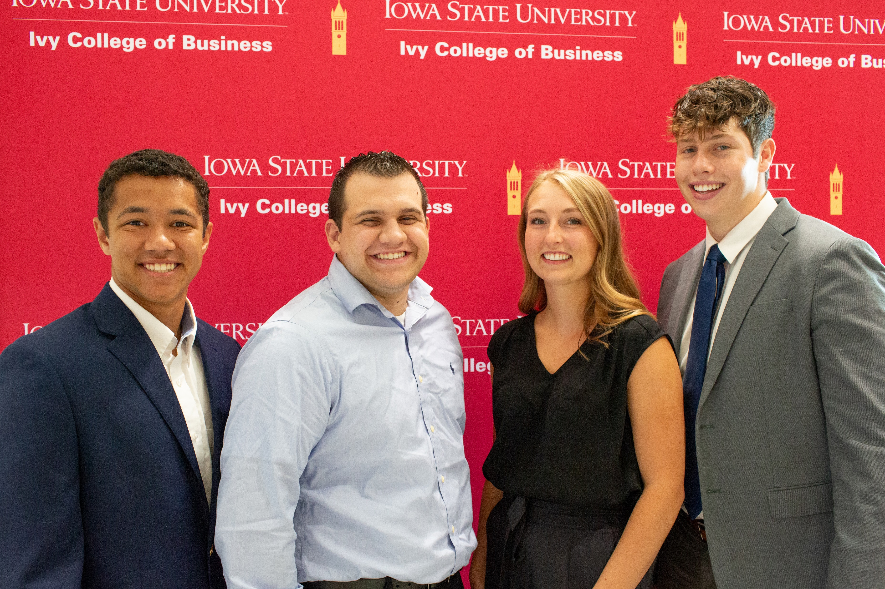
Our team
Dewayne
Caldwell
Anthony
Rampino
Halle
Nanninga
Charlie Moreland
Notes:
Everyone

Slide 3
Executive Summary
OpenAI
Key Issues
Recommendations
Unfocused Scaling
Prioritizing Innovation Over Safety
Societal Impacts
Increase Utilization of B2B model
Invest in Computing Power
Rebalance Innovation and Safety
Notes:
Dewayne

Slide 4
Problem Statement
How will OpenAI meet growing demand and remain a market leader, while continuing to prioritize ethical innovation?
Notes:
Dewayne

Slide 5
Key Issue – Unfocused Scaling
Lack of Computing Capacity
Cannot Fulfill User Demand
Underutilized Competitive Advantages
Untapped Consumer Growth Potential
Innovation Doesn’t Meet Consumer Needs
Parameters Without Purpose
Notes:
Halle

Slide 6
Key Issue – Prioritizing Innovation Over Safety
Data Dilution
Increased Misinformation
Intelligence Explosion
Loss of Trust in AI
High Innovation Speed
Infrastructure Lag
Notes:
Anthony

Slide 7
Key Issue – Societal Impacts
Potential Government Regulations
Limited Functionality
Societal Backlash
Declining User Base
Reluctance to Adopt
Industry Failure
Notes:
Charlie
Misinformation (Fear) - Misinformation (Fear)

Slide 8
Recommendation - Increase B2B Utilization
Encourage Utilization of OpenAI Licenses and API’s
How:
Market underutilized functions
Increase consumer education
Promote business testimonials
Adoption of at least 1 business function (2023)
Why:
Increases token use
Increases switching costs
Long term revenue
Using AI
72%
using Generative AI
65%
Notes:
Halle

Slide 9
Recommendation - Increase B2B Utilization
Ease of Business Integration
How:
Scale back LLM research hires
Use saved costs to fund user experience initiatives and onboarding materials
Why:
Decrease the learning curve of implementing OpenAI API into business processes
Increased accessibility grows consumer base
“Labour Productivity improvements are expected to account for over 55% of all GDP gains from AI over the period 2017 – 2030”
- PwC Analysis
Notes:
Charlie

Slide 10
Recommendation – Upscale Capacity
Microsoft Funded Increase of Computing Power
How:
Strategic Alignment with Microsoft
Leverage Microsoft’s GPU manufacturing Competency
Increase OpenAI dedicated Microsoft GPUs
2019
Several Billion $ Investments from Microsoft
Why:
User Accessibility: Meet computing needs of increased demand
Accelerate the ROI Timeline of Microsoft’s investments
Microsoft Share
Of OpenAI
49%
Notes:
Charlie
2015 – Founding Members Invest $1B
2018 – Microsoft Invests $1B
2019 – Undisclosed Larger Microsoft Investments
2019 – Microsoft Acquires 49%
2024 – OpenAI Valuation of $150B

Slide 11
Recommendation – Hybrid Approach
Slow the rate of innovation and focus on safety and trust
How:
Allocate innovation resources towards content filtering
Delay next generation models
Cyber security initiatives
Why:
Maintain model quality
Protect user data
Already a market leader
Recommended Position
Current Position
Safety
Innovation
Notes:
Halle

Slide 12
Timeline
The reorganized business is operational
50% of Microsoft GPUs delivered
Develop OpenAI computing centers
Review position in the market
Year 0
Year 2
Approach Microsoft to increase computing capacity
Begin human capital reorganization
Plan and implement B2B marketing program
Year 1
Evaluation of B2B Marketing Programs
Remaining Microsoft GPUs are delivered
Re-evaluate current AI market demand
Year 5
Notes:
Dewayne

Slide 13
KPI’s
Categories | Measurables | Improvement
B2B
 | Token Usage | 10%-15% Increase
 | Number of Businesses | 5%-10% Growth
Computing
 | Number of GPUs | 100,000 Units
 | Subscriber Waitlists | 0 Waitlists
Safety
 | Incident Reporting | 25% Decrease
Notes:
Dewayne

Slide 14
Risk Mitigation
Risk
Microsoft not complying with request for more funding
Look else where for funding and invest in independent Infrastructure
Consumers value innovation over safety
Constant evaluation of Consumer Values Alignment
Loss of Market Leadership in Direct-to-Consumer Model
Focus on Priority Market, B2B with the most potential for Revenue
Notes:
Anthony

Slide 15
Financial Valuation
Estimated Cost of Increased Computing Capacity
98.1
Estimated LLM-Level GPU Cost | $20,000
Estimated Supplier Markup | 20%
Estimated Microsoft GPU Wholesale | $16,000
Quantity Requested | 100,000
Total Cost | $1.6 Billion
OpenAI Price-to-Sales Ratio
Based on $157B Valuation and $1.6B Revenue (2023)
Past Microsoft Investments in OpenAI have been in this range
Notes:
Anthony
Not maintainable Investors need to see Returns on their investment
Past Microsoft investments of >$1B investments to the research aspect will be willing to make similar investment that speeds up timeline of Revenue Growth

Slide 16
Recommendation Summary
OpenAI
Recommendations
Strategic Impact
Improve B2B Model
Increased Market Share
Investment in Computing Infrastructure
Increased Product Reliability and Availability
Hybrid Approach to Development and Safety
Innovation That Establishes Consumer Trust
Notes:
Halle

Slide 17
Appendix

Slide 18
Appendix – Table of Contents
Pestel Analysis
Increase B2B Utilization – User Numbers
Increase B2B Utilization
AI Refinement B2B Partnerships – Prompt
AI Refinement B2B Partnerships – Response
AI Refinement B2B Partnerships – Use
Invest in Computing Capacity
Invest in Computing Capacity – Costs
AI Refinement Invest in Computing capacity- Prompt
AI Refinement Invest in Computing capacity- Response
AI Refinement Invest in Computing capacity- Uses
Balancing Innovation and Safety
Timeline

Slide 19
Pestel Analysis
Political | Economic | Social | Technological | Environmental | Legal
Government regulation will have an influence on the direction of the business and how the company determines their ethics principles. | Includes resources from investment for R&D and capability improvement. Analysis is also required for market demand. | AI companies rely on the public believing that AI benefits humanity as a whole. | OpenAI must remain as a market leader for integration and innovation for relevent industries. | AI can have a high footprint due to computing power, but can also be used to find efficient solutions. | Legal can be the basis behind ethics and compliance regulations.

Slide 20
Increase B2B Utilization – User Numbers
Current Users:
65% of businesses use at least 1 Generative AI function
72% of businesses use at least 1 AI function
Generative AI saw a 33% user growth from 2023-2024
Expectations:
5-10% annual growth in number of businesses using Generative AI
By 2025 We expect 82% and 75% of businesses to use at least 1 Generative AI function
How can we encourage business users to increase their function utilization (2+ functions)?
Dependence generates long term revenue

Slide 21
Increase B2B Utilization
What: Encourage Utilization of OpenAI Licenses and API’s at a B2B level by providing education and strategically marketing product capabilities through B2B Development.
How:
Deployable Products
User friendly, safe, trustworthy, ethical
Increase functional attractiveness to key consumer groups
Market underutilized AI use functions (increase token use/complexity of request)
Bottom 3: Predictive Service and Intervention, Customer-service analytics, Sales.
How can you encourage companies who have bought into one function to integrate additional functions
Optimize Talent allocation to focus on B2B UI/UX
Save costs of investing in LLM Innovation talent
Shift resources toward teams that increase the accessibility and deployability of OpenAI’s LLMS
Higher utilization increases switching costs for consumers
Risks:
Not being able to meet consumer/token demand
Liability
Data dilution – how do you protect AI data quality from increased usage
Government regulation against specific functions

Slide 22
AI Refinement B2B Partnerships - Prompt
Evaluate the following business strategy for OpenAI. We believe that OpenAI should encourage utilization of OpenAI licenses and API’s at a B2B level by providing education and strategically marketing product capabilities through B2B Development. OpenAI should make its B2B products more deployable by emphasizing user friendliness, safety, and trustworthiness. OpenAI should Increase functional attractiveness to key consumer groups and market underutilized AI use functions. Increasing utilization would increase token use and complexity of requests resulting in increased revenue. Some functions we believe OpenAI should promote include: Predictive Service and Intervention, Customer-service analytics, and Sales support. Higher utilization rates will increase switching costs for consumers. Further, Open AI should optimize Talent (employee) allocation to focus on B2B UI/UX Save costs of investing in LLM Innovation talent and Shift resources toward teams that increase the accessibility and deployability of OpenAI’s LLMS.

Slide 23
AI Refinement B2B Partnerships - Response
Your business strategy for OpenAI is comprehensive and well thought out. Here are some key points and considerations:
Strengths of the Strategy:
B2B Focus: Emphasizing B2B development can lead to stable, long-term partnerships and recurring revenue streams. Providing education and strategic marketing can help businesses understand the value of OpenAI's products.
User Friendliness, Safety, and Trustworthiness: These are crucial factors for adoption. Businesses need to trust that the tools they are using are safe and reliable.
Functional Attractiveness: By highlighting underutilized AI functions like Predictive Service and Intervention, Customer-service analytics, and Sales support, OpenAI can tap into new markets and use cases.
Increased Utilization: Higher utilization rates can indeed lead to increased revenue through more token use and complex requests.
Switching Costs: Increasing switching costs can help retain customers by making it more difficult for them to move to competitors.
Talent Allocation: Focusing on B2B UI/UX can improve the user experience, making the products more accessible and easier to deploy.
Considerations and Potential Challenges:
Market Education: Educating the market can be resource-intensive. It requires a well-planned strategy to ensure that the right information reaches the right audience.
Balancing Innovation and Accessibility: While focusing on UI/UX is important, it's also crucial to continue investing in LLM innovation to stay ahead of competitors. A balance needs to be struck between these two areas.
Scalability: As utilization increases, ensuring that the infrastructure can handle the increased load without compromising performance or reliability is essential.
Customer Support: With increased utilization, the demand for customer support will also rise. Ensuring that there is adequate support to handle this demand is important for maintaining customer satisfaction.
Competitive Landscape: The AI market is highly competitive. Continuous monitoring of competitors and adapting strategies accordingly will be necessary.
Recommendations:
Pilot Programs: Implement pilot programs with select businesses to showcase the benefits and gather feedback for further improvement.
Partnerships: Form strategic partnerships with industry leaders to enhance credibility and reach.
Continuous Improvement: Regularly update and improve the product based on user feedback and technological advancements.
Marketing Campaigns: Develop targeted marketing campaigns to highlight the unique features and benefits of OpenAI's B2B products.
Overall, your strategy has a solid foundation. By addressing the potential challenges and continuously adapting to the market, OpenAI can effectively increase its B2B presence and revenue.

Slide 24
AI Refinement B2B Partnerships - Use
Things we changed:
Share key partnerships and testimonials with new and existing consumers
Increase clarity about education offerings
Webinars, sales calls, customer support, product training.

Slide 25
Invest in Computing Capacity
What: Increase GPU Capacity (Number of) specifically for the use of OpenAI
How & Why:
Short Term: Joint Venture with Microsoft
Microsoft has significant capital and is a major investor in OpenAI
Increased capacity helps OAI to meet consumer demand
Promotes an increase in userbase (program speed & reliability)
More immediate return on investment
Long Term: Invest in OpenAI computing centers
Decreases reliance on Microsoft
System Failure
Mitigates risk if partnership dissolves
Keeps profit in house
Risks:
Demand doesn’t increase (Market becomes saturated)
Microsoft rejects request – aligning Microsoft stakeholders
Partnership collapse
High Cost
Users value innovation over ethical, accessible product.

Slide 26
Invest in Computing Capacity - Costs
Estimated GPU Cost (Market): $20000
Estimated Supplier Markup: 20%
Estimated Microsoft GPU wholesale cost: $16000
Quantity requested: 100,000 units
Total Cost: $1.6 B

Slide 27
AI Refinement Invest in Computing capacity- Prompt
I am making a strategic recommendation for OpenAI will you analyze my recommendation like you are a strategic business expert. My recommendation is for OpenAI to have Microsoft invest in scaling up Microsoft azure computing capacity with its GPUs. This will allow OpenAI to have a larger computing capacity and meet and increase in demand

Slide 28
AI Refinement Invest in Computing capacity- Response
Your recommendation for OpenAI to leverage Microsoft's investment in scaling up Azure's GPU computing capacity is strategically sound but let me analyze it in detail with a focus on the potential benefits, risks, and considerations.
### **Strategic Analysis of the Recommendation**
#### **Strengths of the Recommendation**
1. **Synergy with Existing Partnership**:
- OpenAI already has a strong partnership with Microsoft, including integration with Azure and co-development projects.
- Further leveraging this relationship aligns with the strategic direction of mutual growth and dependency.
2. **Addressing Increased Demand**:
- The demand for AI capabilities, particularly large-scale models, is growing exponentially.
- Scaling GPU capacity ensures OpenAI can handle the computational requirements of its expanding customer base and product offerings (e.g., ChatGPT, Codex, DALL-E).
3. **Cost and Efficiency Benefits**:
- Partnering with Microsoft rather than building proprietary infrastructure reduces CAPEX for OpenAI.
- Azure's existing infrastructure and expertise in scalability allow for faster deployment and lower operational risks.
4. **Market Positioning**:
- Enhanced computational capacity strengthens OpenAI’s position as a leader in AI technology.
- A stronger reliance on Azure reinforces OpenAI's branding through Microsoft’s enterprise credibility.
#### **Potential Risks and Challenges**
1. **Dependency Risk**:
- Over-reliance on Microsoft could limit OpenAI’s independence and negotiating power in the long term.
- Microsoft’s strategic priorities may not always align with OpenAI’s, especially if conflicting demands arise from other Azure customers.
2. **Scalability Constraints**:
- While Azure's GPU capacity can be scaled, there may still be latency or supply chain challenges in securing cutting-edge GPUs during periods of global demand.
3. **Competitive Pressures**:
- This dependency could expose OpenAI to competitive risks, as rivals (e.g., AWS, Google Cloud) may develop proprietary AI solutions that outperform Azure’s offerings.
- Other AI players building their own infrastructure may achieve cost advantages over time.
4. **Cost Implications**:
- Increased investment in Azure capacity could lead to higher operational costs if not managed effectively.
- OpenAI would need to ensure that the revenue from additional capacity offsets these costs.
#### **Strategic Considerations**
1. **Diversification**:
- Consider diversifying computing partnerships to mitigate dependency risks.
- A hybrid model involving Azure as a primary partner with a backup plan through other cloud providers could be beneficial.
2. **Control Over Core Infrastructure**:
- Assess the feasibility of developing proprietary infrastructure in the medium-to-long term to maintain independence and reduce costs.
3. **Alignment of Goals**:
- OpenAI should establish clear terms in its agreements with Microsoft to ensure that both parties’ strategic goals remain aligned.
- Joint planning for future technological developments will mitigate misaligned incentives.
4. **Customer Focus**:
- Ensure that increased capacity translates into tangible benefits for OpenAI’s users, such as improved model responsiveness, lower latency, and broader accessibility.
### **Conclusion**
The recommendation to have Microsoft invest in scaling up Azure’s GPU capacity aligns with OpenAI’s immediate and medium-term needs for computational resources. However, OpenAI should mitigate risks by balancing this partnership with longer-term plans for diversification and potential self-reliance. Strategically, this move supports growth, but execution and contractual safeguards are critical to maximizing its benefits.

Slide 29
AI Refinement Invest in Computing capacity- Uses
Added the 5-year plan for an independent OpenAI initiative to increase their own computing capacity. The threat of dependence on Microsoft is real and OpenAI needs to ensure that they mitigate this risks be having their own initiatives.
We modified the timeline to accommodate for the lead-times that would occur with the purchase of 100,000 GPU’s since we can assume that most technology lead-times hover from roughly 6 months to a year depending on the demands of other consumers and relative firms.

Slide 30
Balancing Innovation and Safety
What: Slow the rate of innovation. Shift saved resources towards investment in content filtering development. to focus resources on model safety. Remain Closed, focus on consumer trust.
Why:
Protect users form misinformation and the threat of intelligence explosion.
Already have a market leading technology
Consumer trust and buy-in is important to increasing utilization
Reflects core values
Benefits Humanity as a Whole
How:
Re-allocate research human capital towards content filtering development to maintain model quality
Reduce investment in next generation models.
Cyber security initiatives to protect user data.
Risks:
xAI takes over the market
GPT4 loses competitive edge
Consumers value innovation over safety

Slide 31
Timeline
Year 0
Approach Microsoft to supply increased computing capacity, Microsoft has invested significant amounts of capital to OpenAI already in anticipation of increase in demands. OpenAI has competitive advantage with its partnership and needs to leverage Microsoft's resources.
Begin Human capital reorganization. Shifting from LLM research talent towards enhancement of content filtering system to ensure OpenAI maintains high quality AI models.
Implement B2B Marketing program, Meeting with business IT employees, email marketing, web seminars to educate businesses on how they can increase their integration of OpenAI API into their business processes.
Year 1
Reorganized divisions operational
Content Filtering Development Program
50% of Microsoft GPU units delivered
Year 2
Evaluate B2B market program performance
50% of Microsoft GPU units delivered
Year 3
Year 4
Year 5
Begin Acquiring OpenAI computing centers, this will decrease the amount of reliance OpenAI has on Microsoft while increasing their capacity to

Slide 32
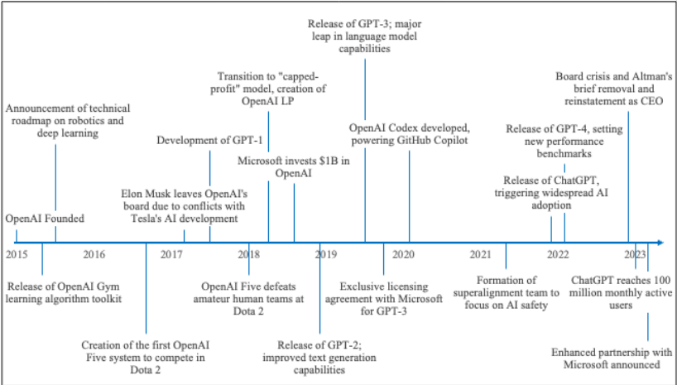
Timeline of Key Milestones in OpenAI Development

Slide 33
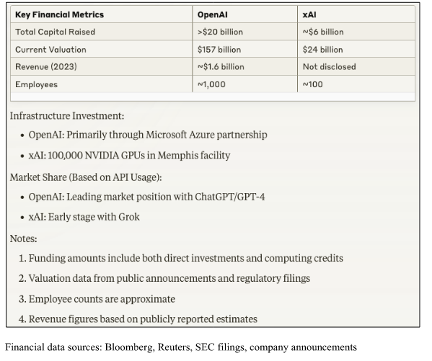
Comparison of funding and valuations, OpenAI vs xAI

Slide 34
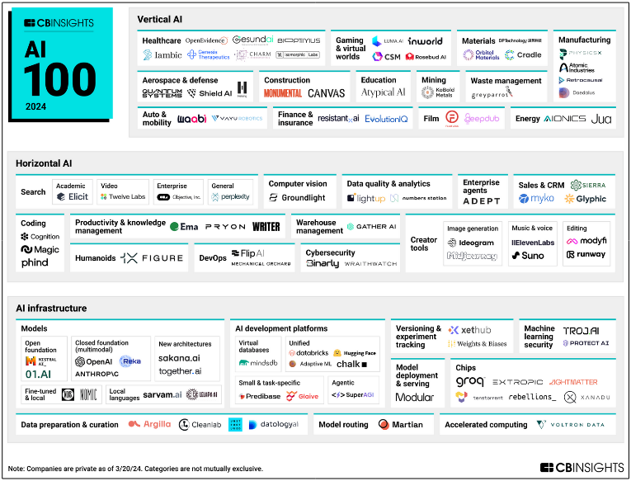
AI Competitive Landscape in 2024

Slide 35
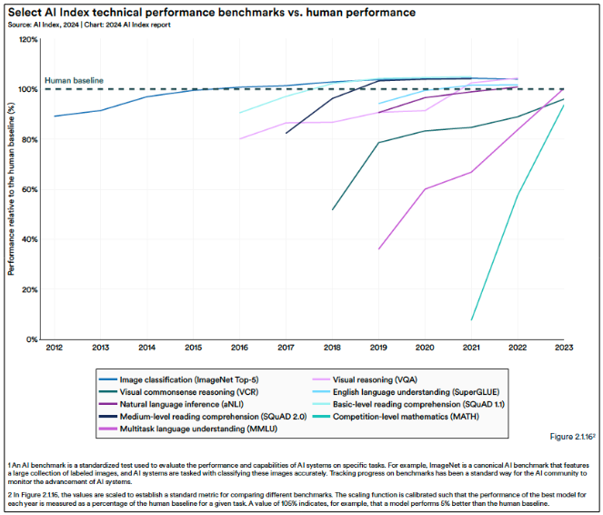

Slide 36
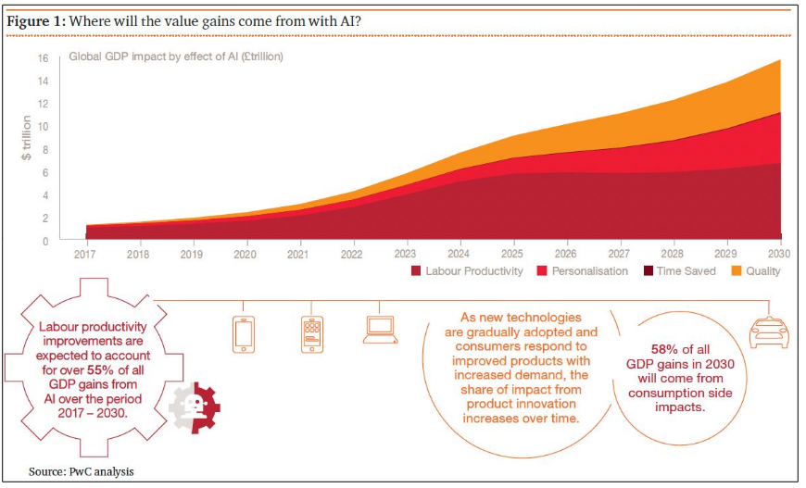

Slide 37
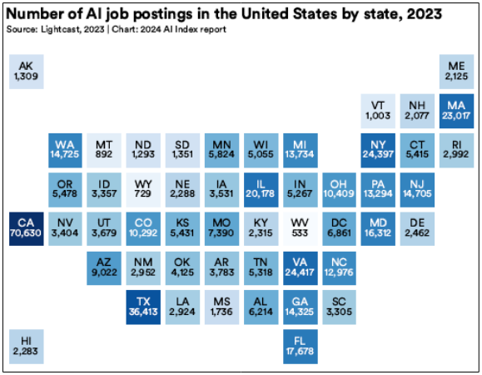

Slide 38
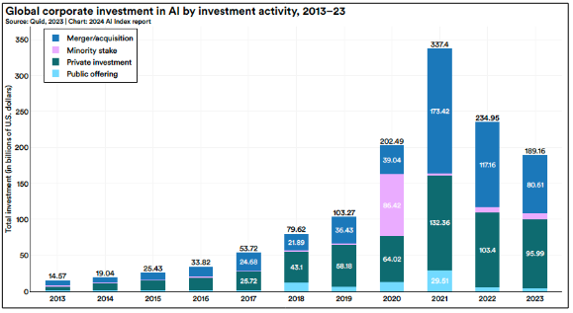

Slide 39
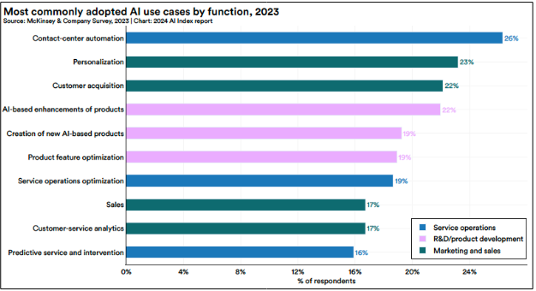

Slide 40
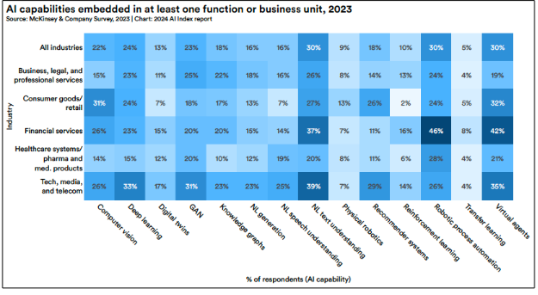

Slide 41
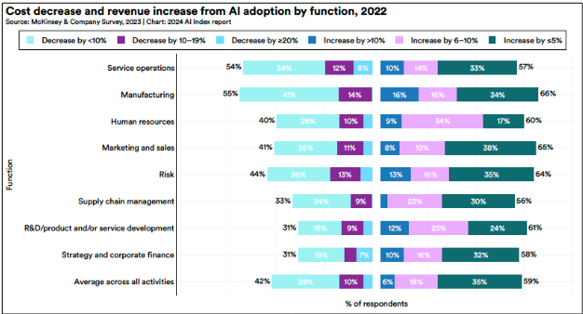

Slide 42
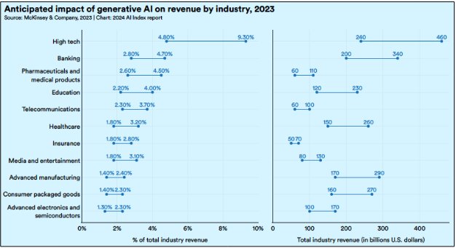

Slide 43
